Slide 1
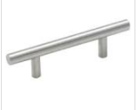
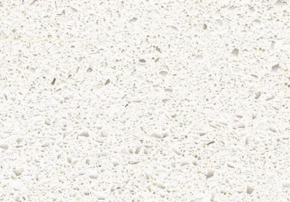



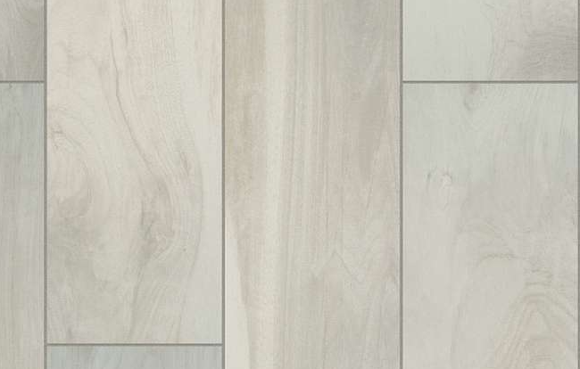
Gold Option 1 Kitchen
Gold Series 1
Nickel(Grey)
Nickel
Cabinet Hardware 154SS
Blanco Maple Quartz
Shaw Silver Mist
Backsplash Shaw-Picket White
Floor Tile- Fine China 7 x 22

Slide 2
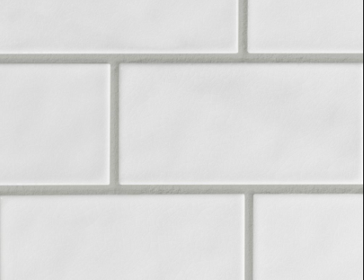
Gold Option 1 Bath
Bath Wall Tile
Wellborn Cabinets
nickel
Floor Tile- Fine China 7 x 22

Slide 3

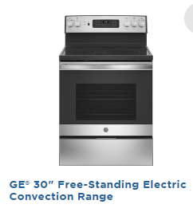
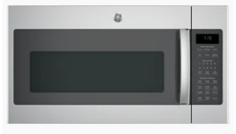
Gold Appliance Package

Slide 4
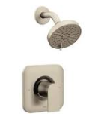
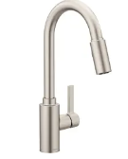
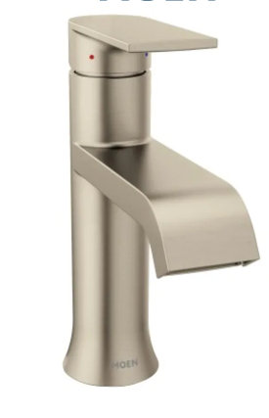
Gold Moen package- Genta

Slide 5

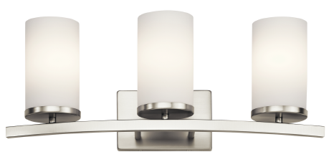
Kichler Package

Slide 6
